Slide 1
Automated superstore
The shelf stalkers

Slide 2
Problem
High HR costs
Miscalculations
Unknown items that are out of stock

Slide 3
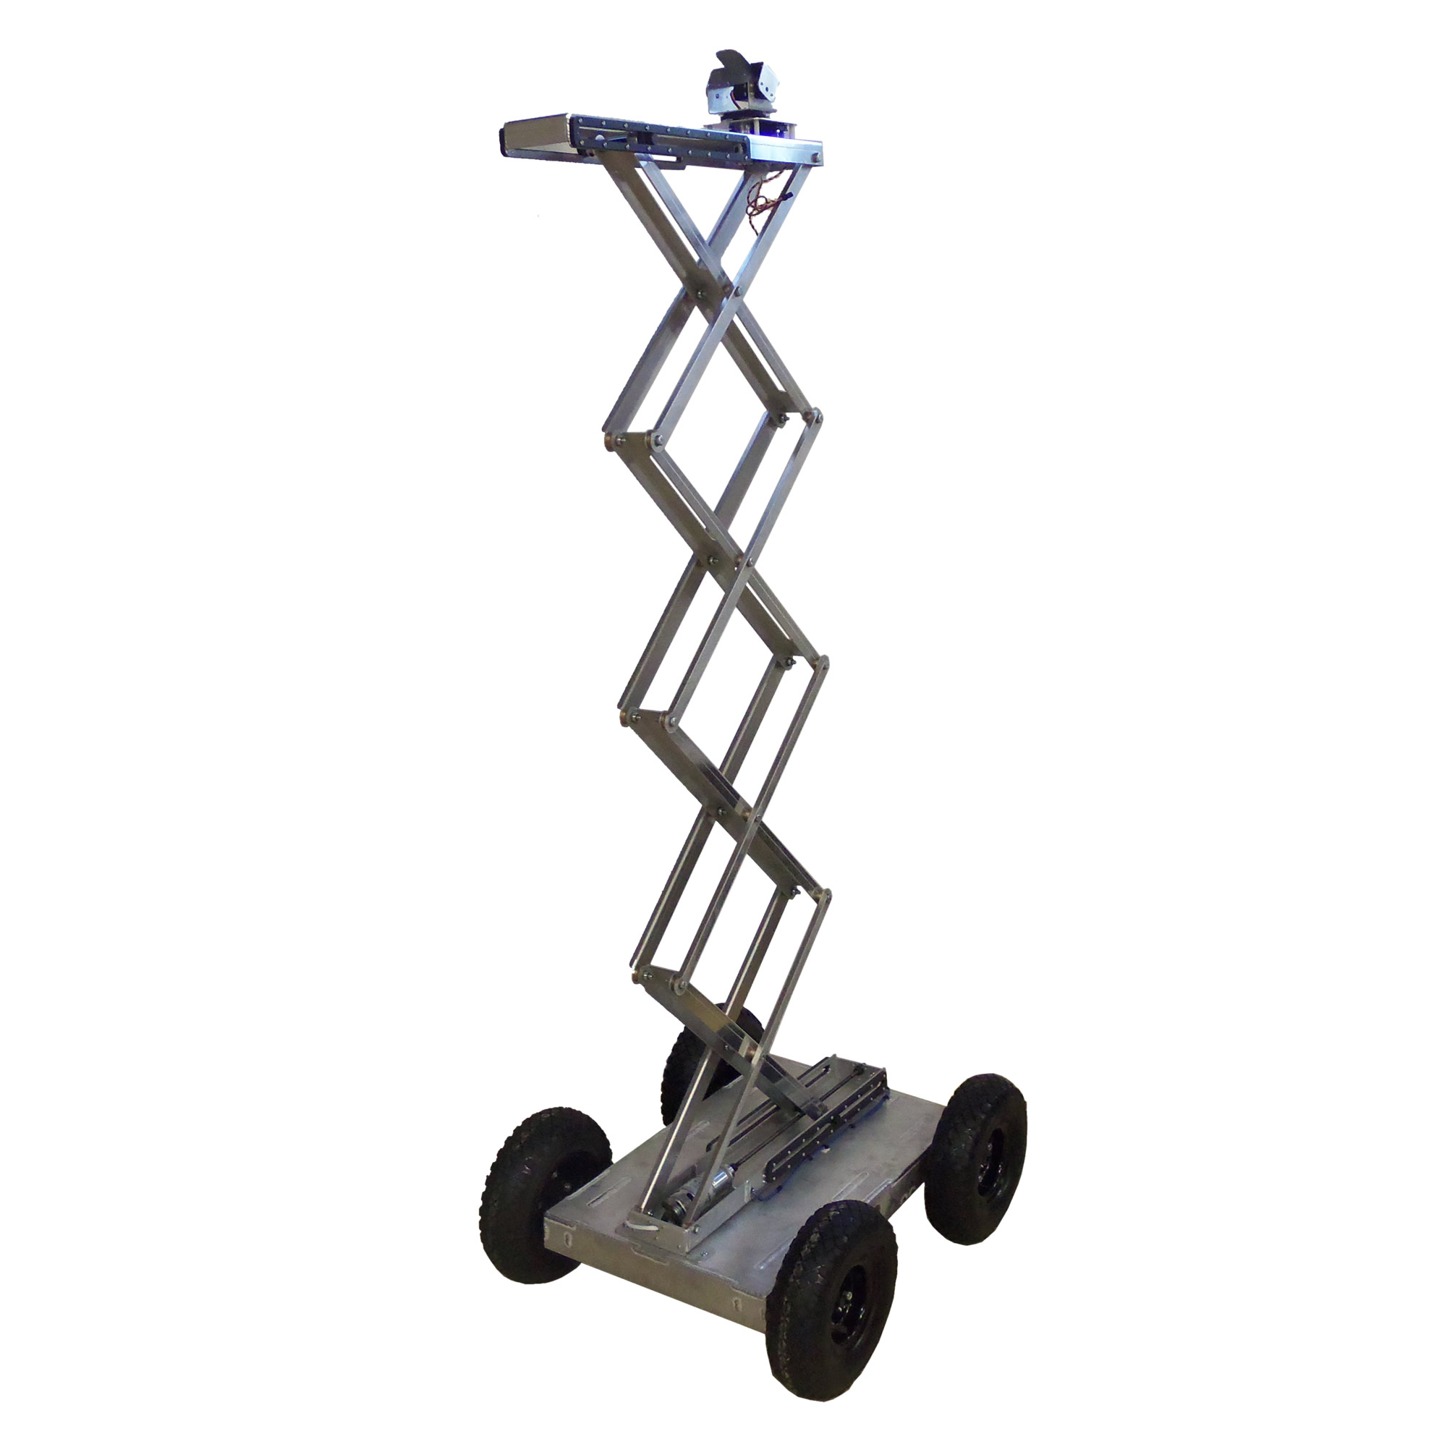
Solution
App
Robots

Slide 4
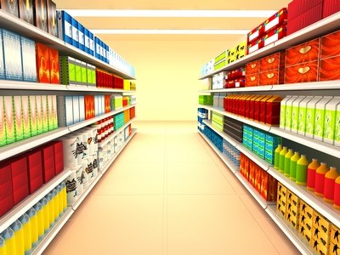
The app

Slide 5
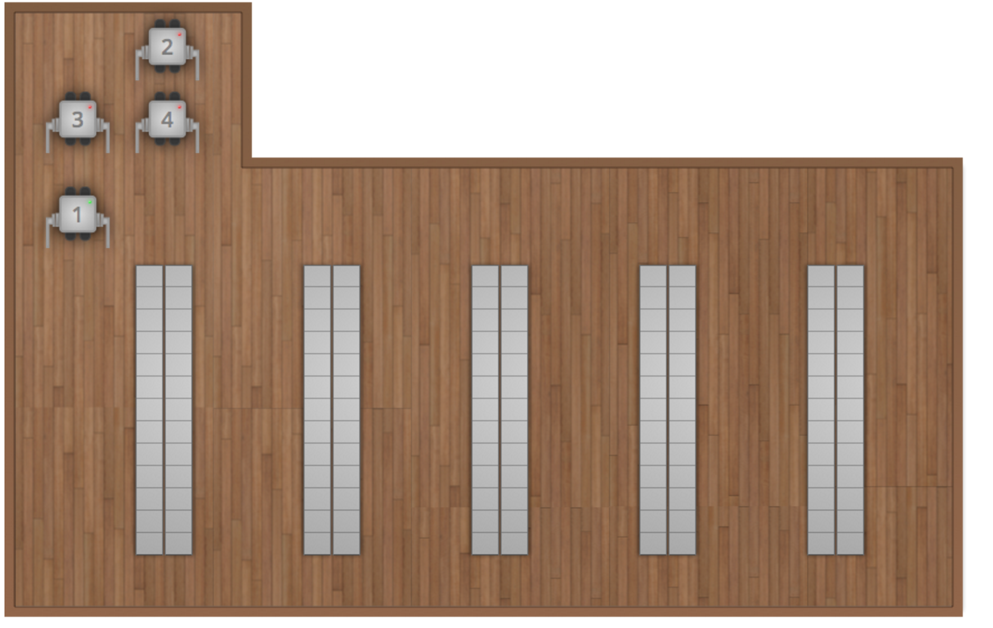
layout

Slide 6
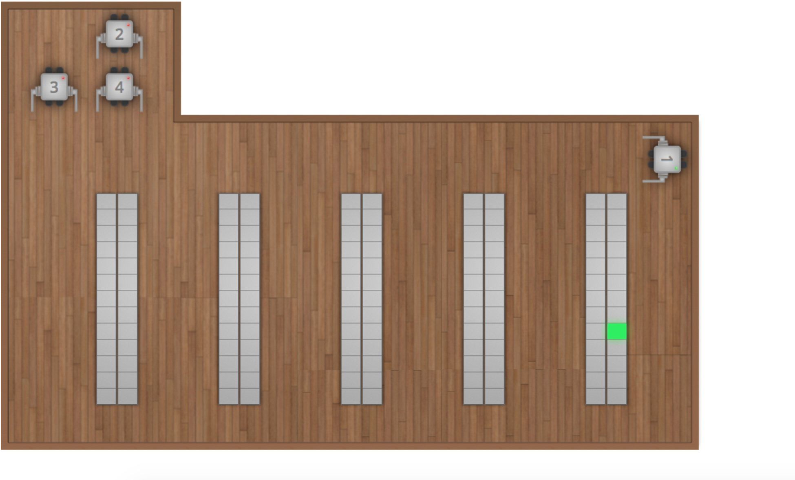
layout
Robot goes to location of out of stock products

Slide 7
References
Lift Image:
http://www.superdroidrobots.com/shop/item.aspx/new-pre-built-4wd-all-terrain-robot-scissor-lift-sold/1685/
Store image:
http://www.brickmeetsclick.com/augmented-reality-grocery-shopping-

Slide 8
Languages
PHP: Database
JavaScript/HTML: Robot simulator
Java/XML: Android App

